Slide 1
Here are just a few of the beautiful works of Leonardo da Vinci!
Enjoy!

Slide 2
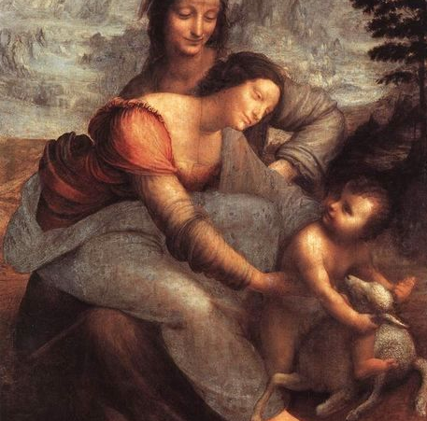
The Virgin and Child with St. Anne

Slide 3
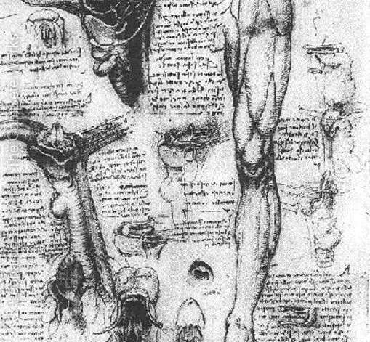
Anatomical Study of Larynx and Leg

Slide 4
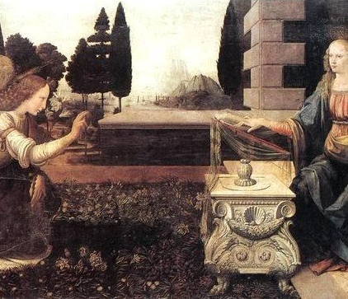
Annunciation

Slide 5
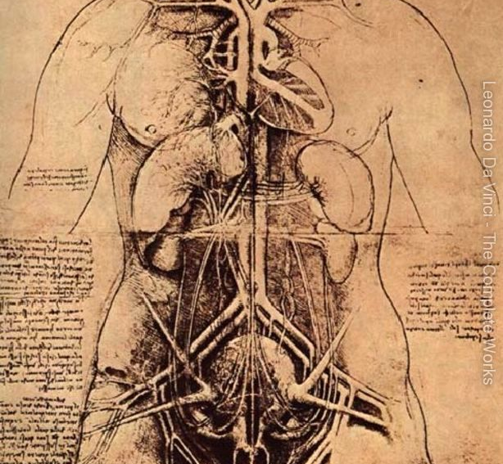
Drawing of a Woman’s Torso

Slide 6
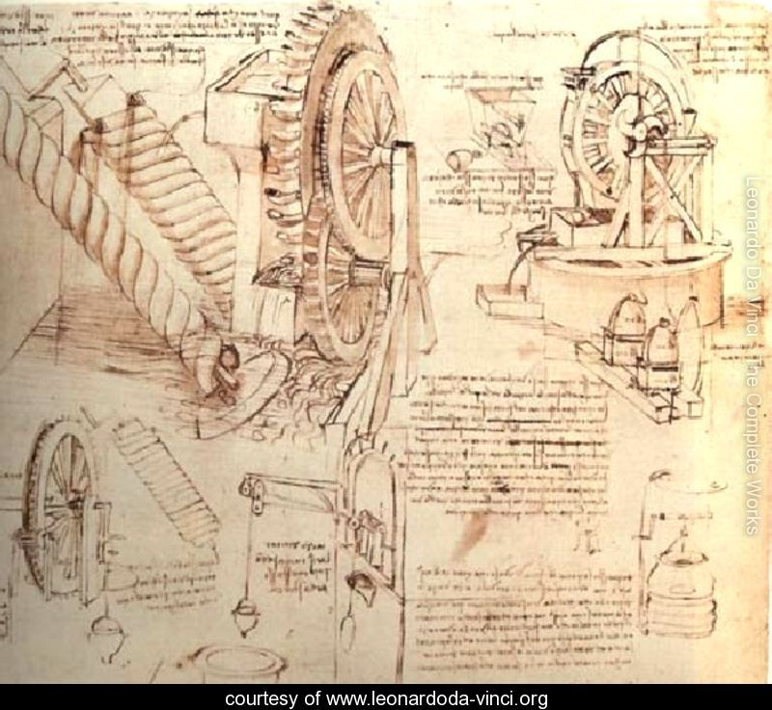
Drawings of a Water Lifting Device

Slide 7
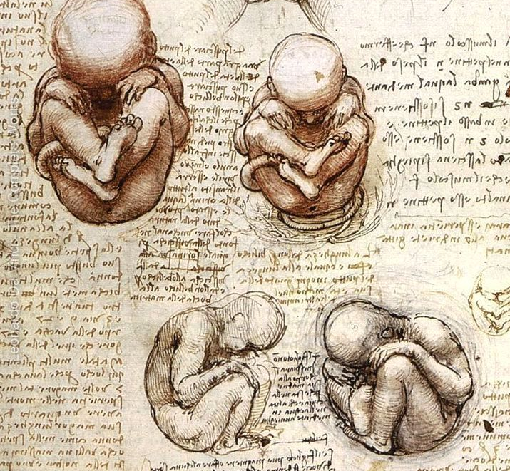
Fetus

Slide 8
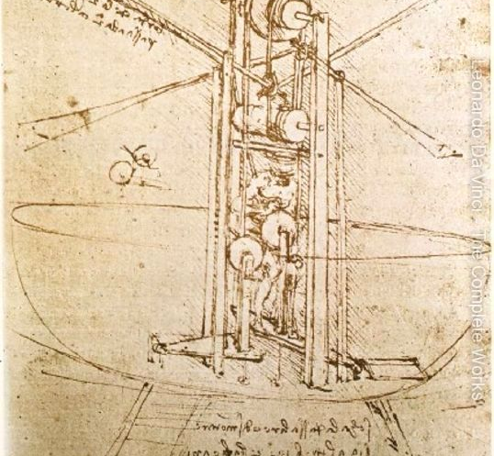
Drawing of Flying Machine

Slide 9
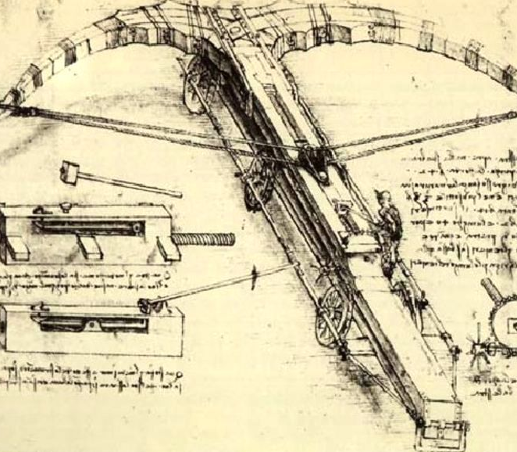
Giant Crossbow

Slide 10
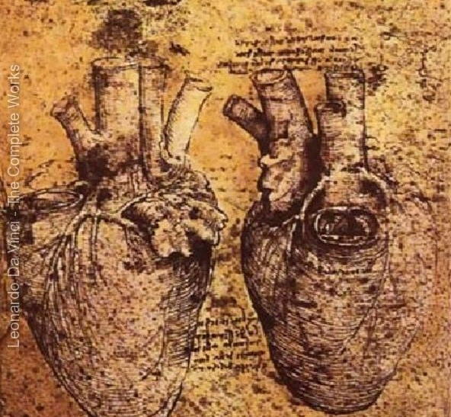
Heart and its Blood Vessels

Slide 11
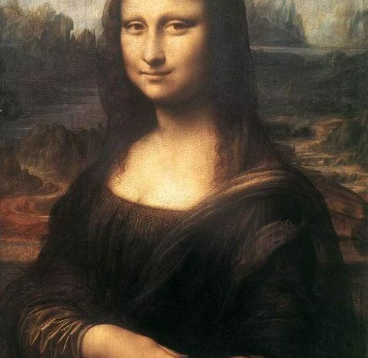
Mona Lisa

Slide 12
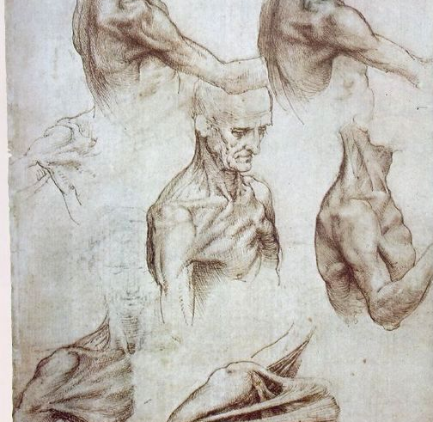
Muscles of the Neck and Shoulders

Slide 13
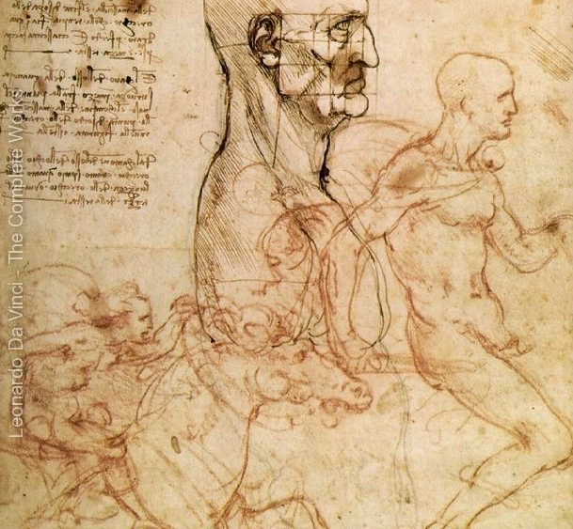
Sketches for the Battle Against Angihari

Slide 14
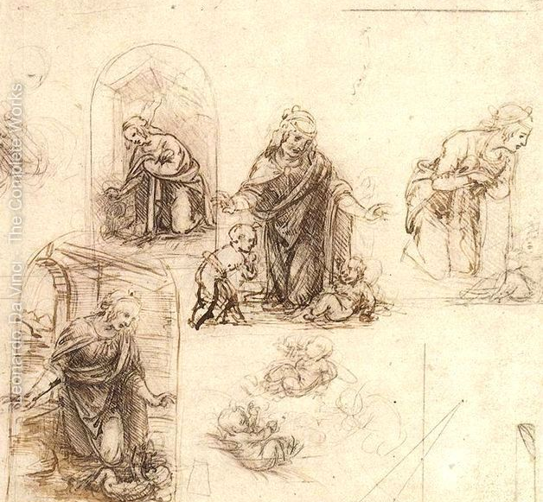
Studies for a Nativity

Slide 15
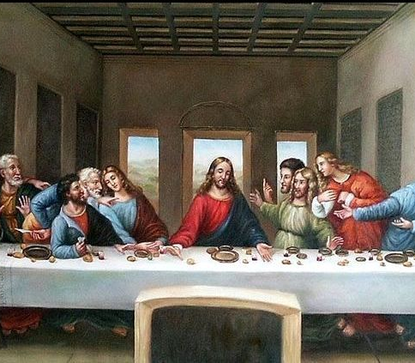
The Last Supper

Slide 16
These were just a few of Leonardo’s great works and if you’re interested on seeing some more the link that follows is a great source! Thank you!
http://www.leonardoda-vinci.org/

